Slide 1



Combining multiple tree rearrangement operators for efficient parsimony inference using reinforcement learning approach
Students: Huỳnh Tiến Dũng, Vũ Quốc Tuấn, Nguyễn Việt Dũng
Science Instructor: TS. Hoàng Thị Điệp
Notes:
Dear judges, teachers, and all attendees of today's research competition, I am honored to present on behalf of our group a brief summary of our research project titled "Combining multiple tree rearrangement operators for efficient parsimony inference using reinforcement learning approach".

Slide 2
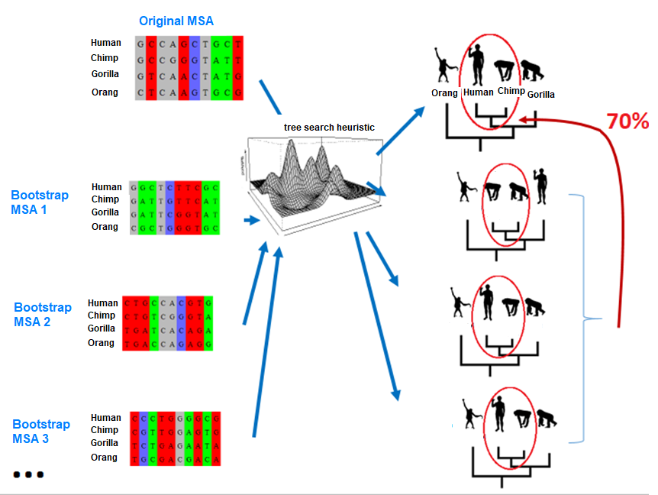
MPBoot
Notes:
MPBoot is a tool designed to analyze evolutionary trees generated using the bootstrap method. In addition to constructing the trees, MPBoot also assesses the reliability of the edges. What sets MPBoot apart from other tools is its use of an approximation technique, which results in faster processing times.

Slide 3
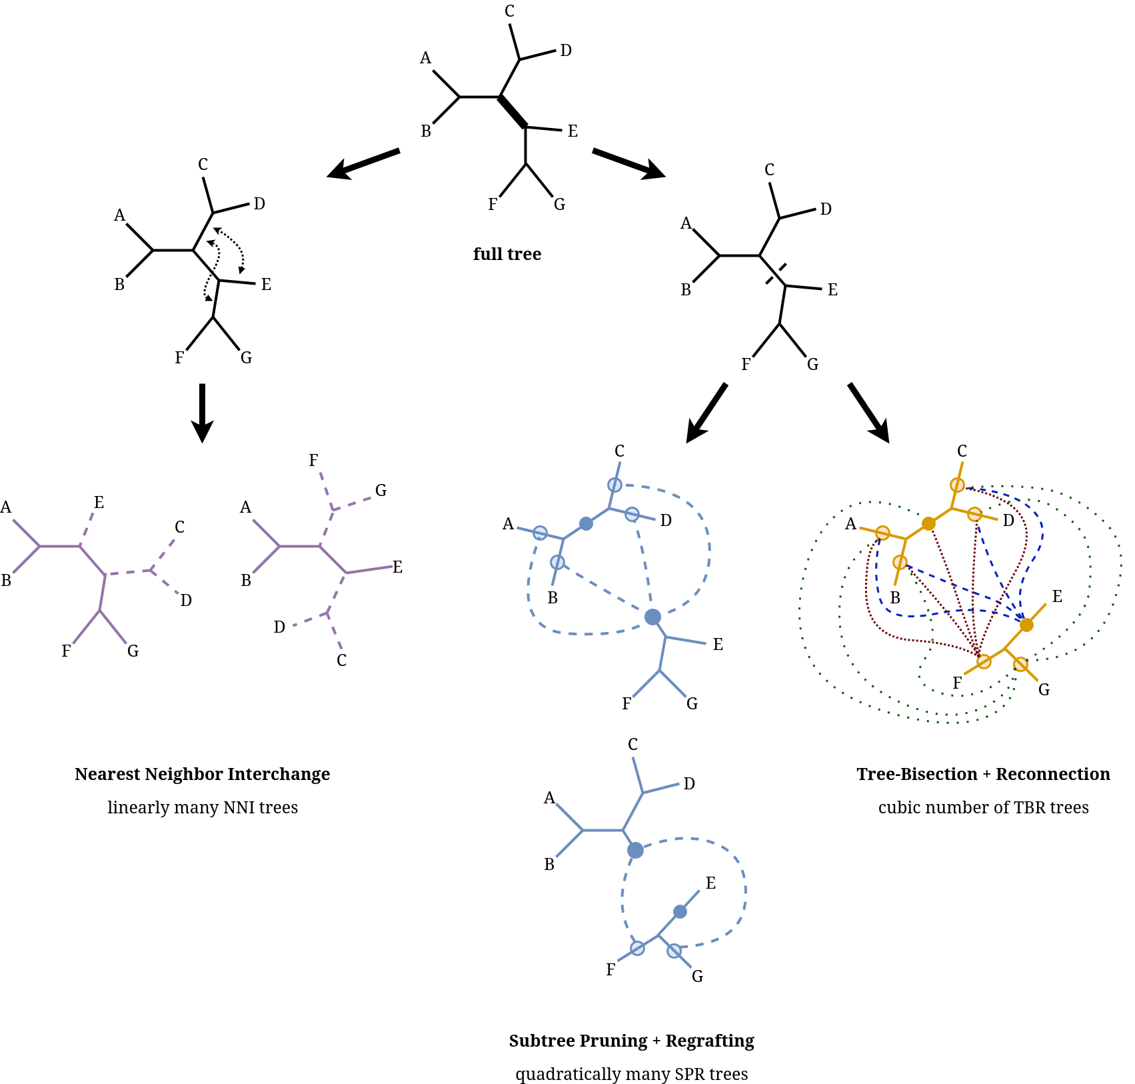
TBR is more comprehensive than SPR, but it has not been integrated into MPBoot yet.
TBR is complex and difficult to implement.
SPR is used throughout the framework of MPBoot
Notes:
MPBoot solely utilizes SPR transformation currently, but incorporating TBR, which is more exhaustive, could result in more accurate MP trees and bootstrap sets. However, this is a difficult and complex task.

Slide 4
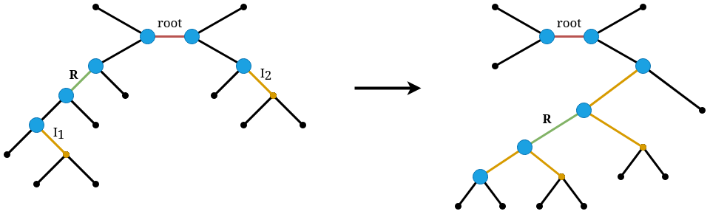
Fast Evaluation of a TBR Move
Best search strategy
MPBoot-TBR-best
Better search strategy
MPBoot-TBR-better
Notes:
Our group proposes a method for rapidly computing the MP score after one TBR operation and two hill-climbing search strategies: MPBoot-TBR-best and MPBoot-TBR-better.

Slide 5
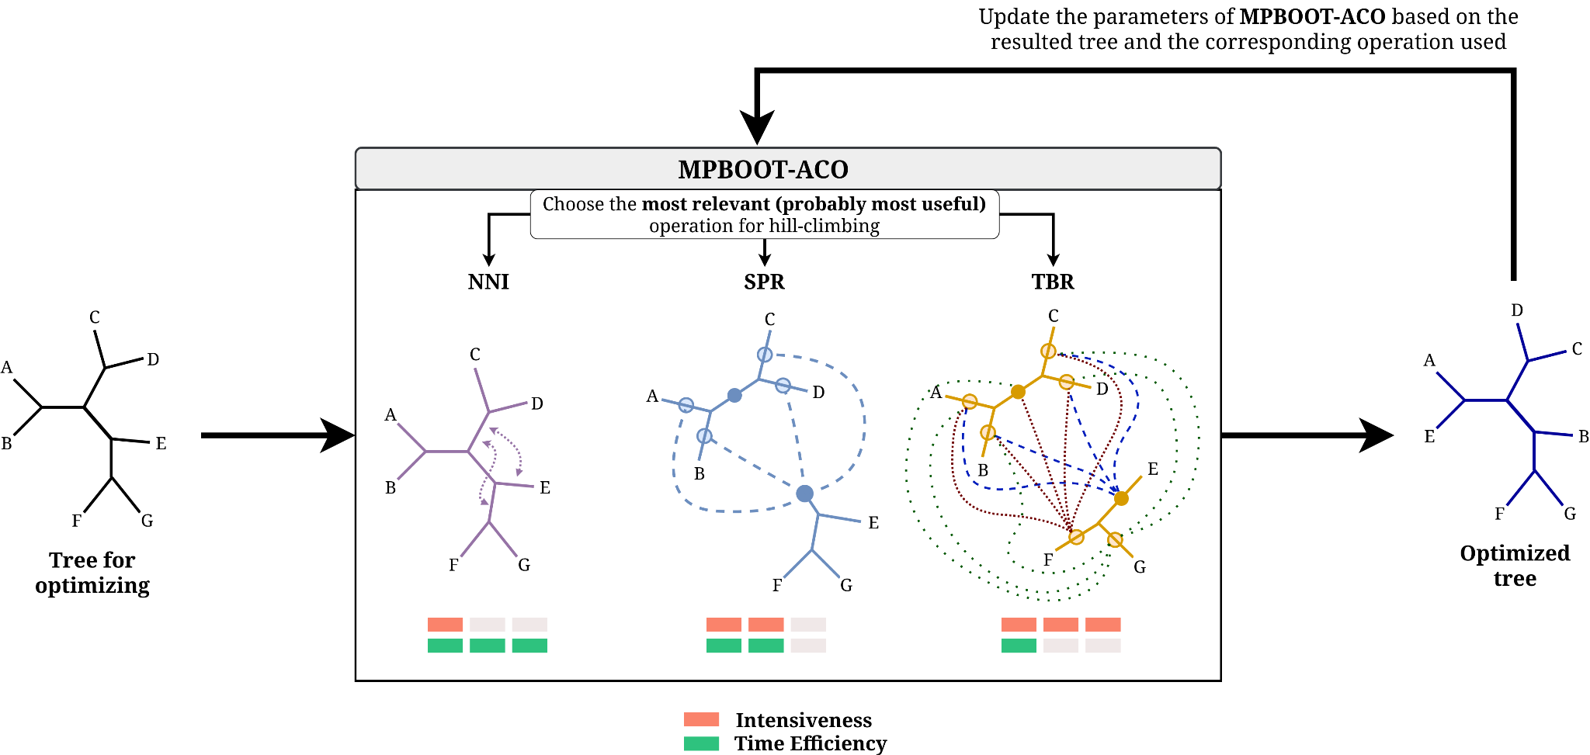
Ant Colony Optimization
Notes:
We propose MPBoot-ACO which integrates TBR transformation and utilizes ant colony optimization algorithm to combine NNI, SPR, and TBR transformations. This exploits the strengths of each transformation based on the input data.

Slide 6
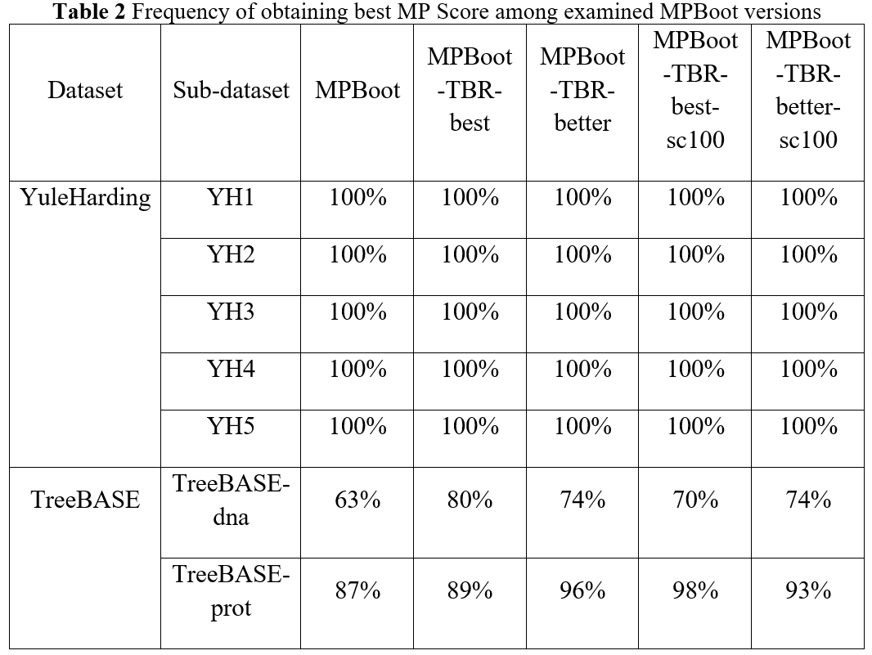

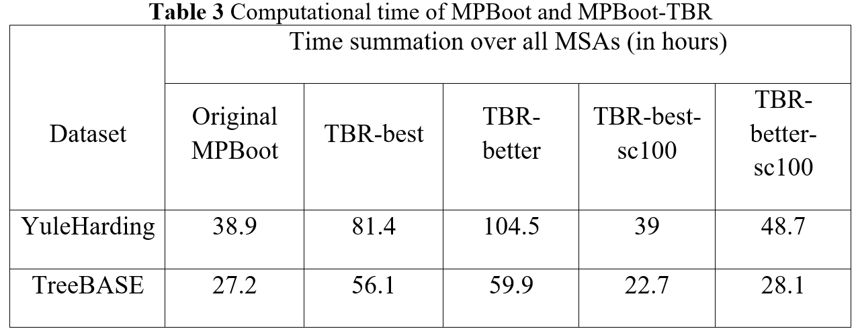
Notes:
Our group implemented and tested the MPBoot-TBR and MPBoot-ACO versions and found that MPBoot-TBR produced superior MP scores while maintaining comparable processing times to the original version.

Slide 7
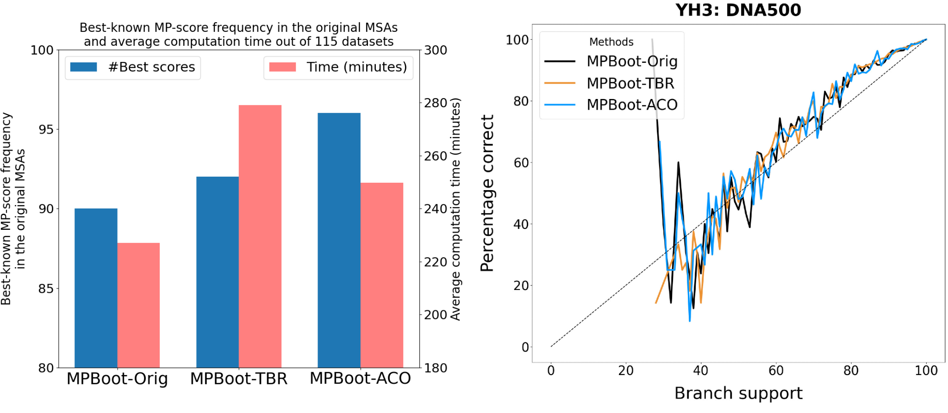
Notes:
The MPBoot-ACO version, which uses the ant colony optimization algorithm, yields better results in terms of MP scores and is faster than MPBoot-TBR.

Slide 8

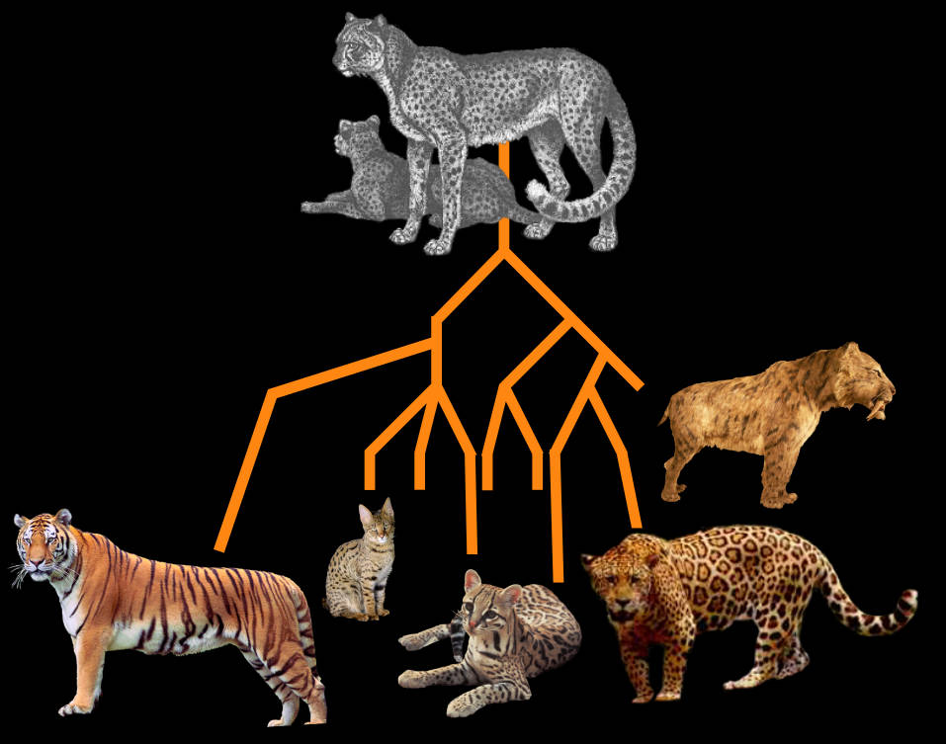



Applications
Notes:
Our work has broad applications in bioinformatics research, including fields such as taxonomy, epidemiology, DNA editing, vaccine research, and animal model selection for drug testing.

Slide 9
Improved sampling performance
High applicability
Open-source code
Notes:
With improved sampling performance, high applicability and open-source code published, we believe that our work will be widely used in other bioinformatics research.

Slide 10
Thank you for listening
Students:
Science Instructor:
Huỳnh Tiến Dũng - 21020007 - K66C-CLC
Vũ Quốc Tuấn - 21020033 - K66C-CLC
Nguyễn Việt Dũng - 21020043 - K66C-A-CLC2
TS. Hoàng Thị Điệp
Notes:
We sincerely appreciate the conference for your attention and listening.

